Slide 1


Indian Institute Of Information Technology Bhagalpur
Sabour,Bhagalpur Bihar

Slide 2
Software Engineering Mini-Project
Accounting System for an organization

Slide 3
Project Submitted By
Group-04
Saksham Gupta 180101039
Karamveer Kumar 180101023
Kunal 180101027
Amar Kumar 180101002
Anupam Dubey 180101009

Slide 4
Problem Statement
Design and develop Accounting System for an organization.
Features:
Project Description:
Create new account
Deposit money
Withdraw money
Balance Enquiry
All account holder list
Close an account
Modify an account
This project uses classes and file handling features of C++. In order to store all the user’s data, an external file (DAT file) is created by the system
Developed using C++ Programming Language and different variables, strings have been used for the development of it.
This project provides the simplest system for managing banking system.

Slide 5
Software Requirement
In order to run the project, you must have installed Dev C++ or Code Blocks on your PC. (we recommend these IDE).
However, it works fine with all the C++ editor and compilers.

Slide 6
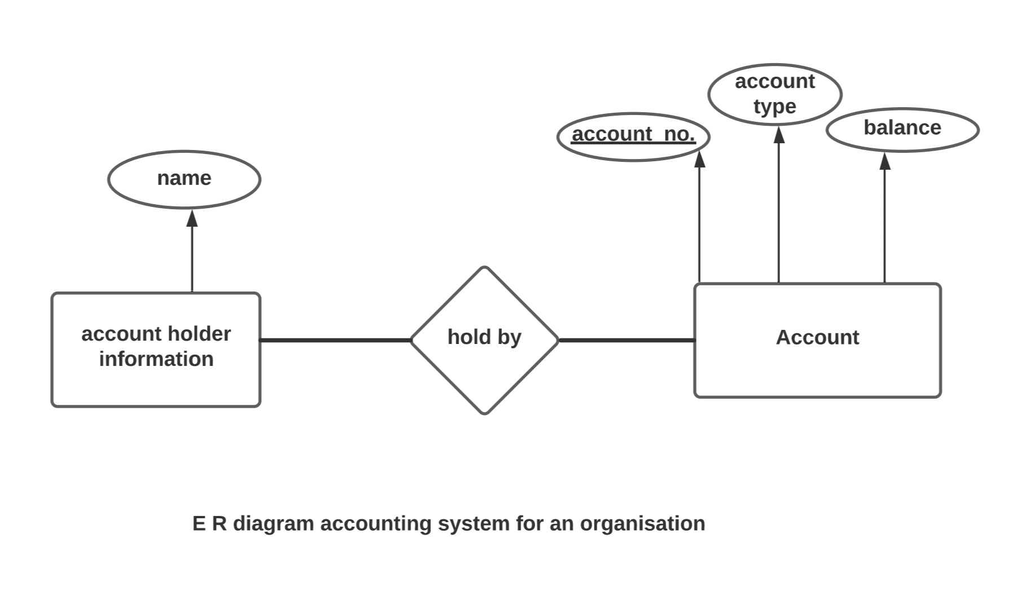
ER-Diagram
ER-Diagram for the accounting System for an organisation.

Slide 7
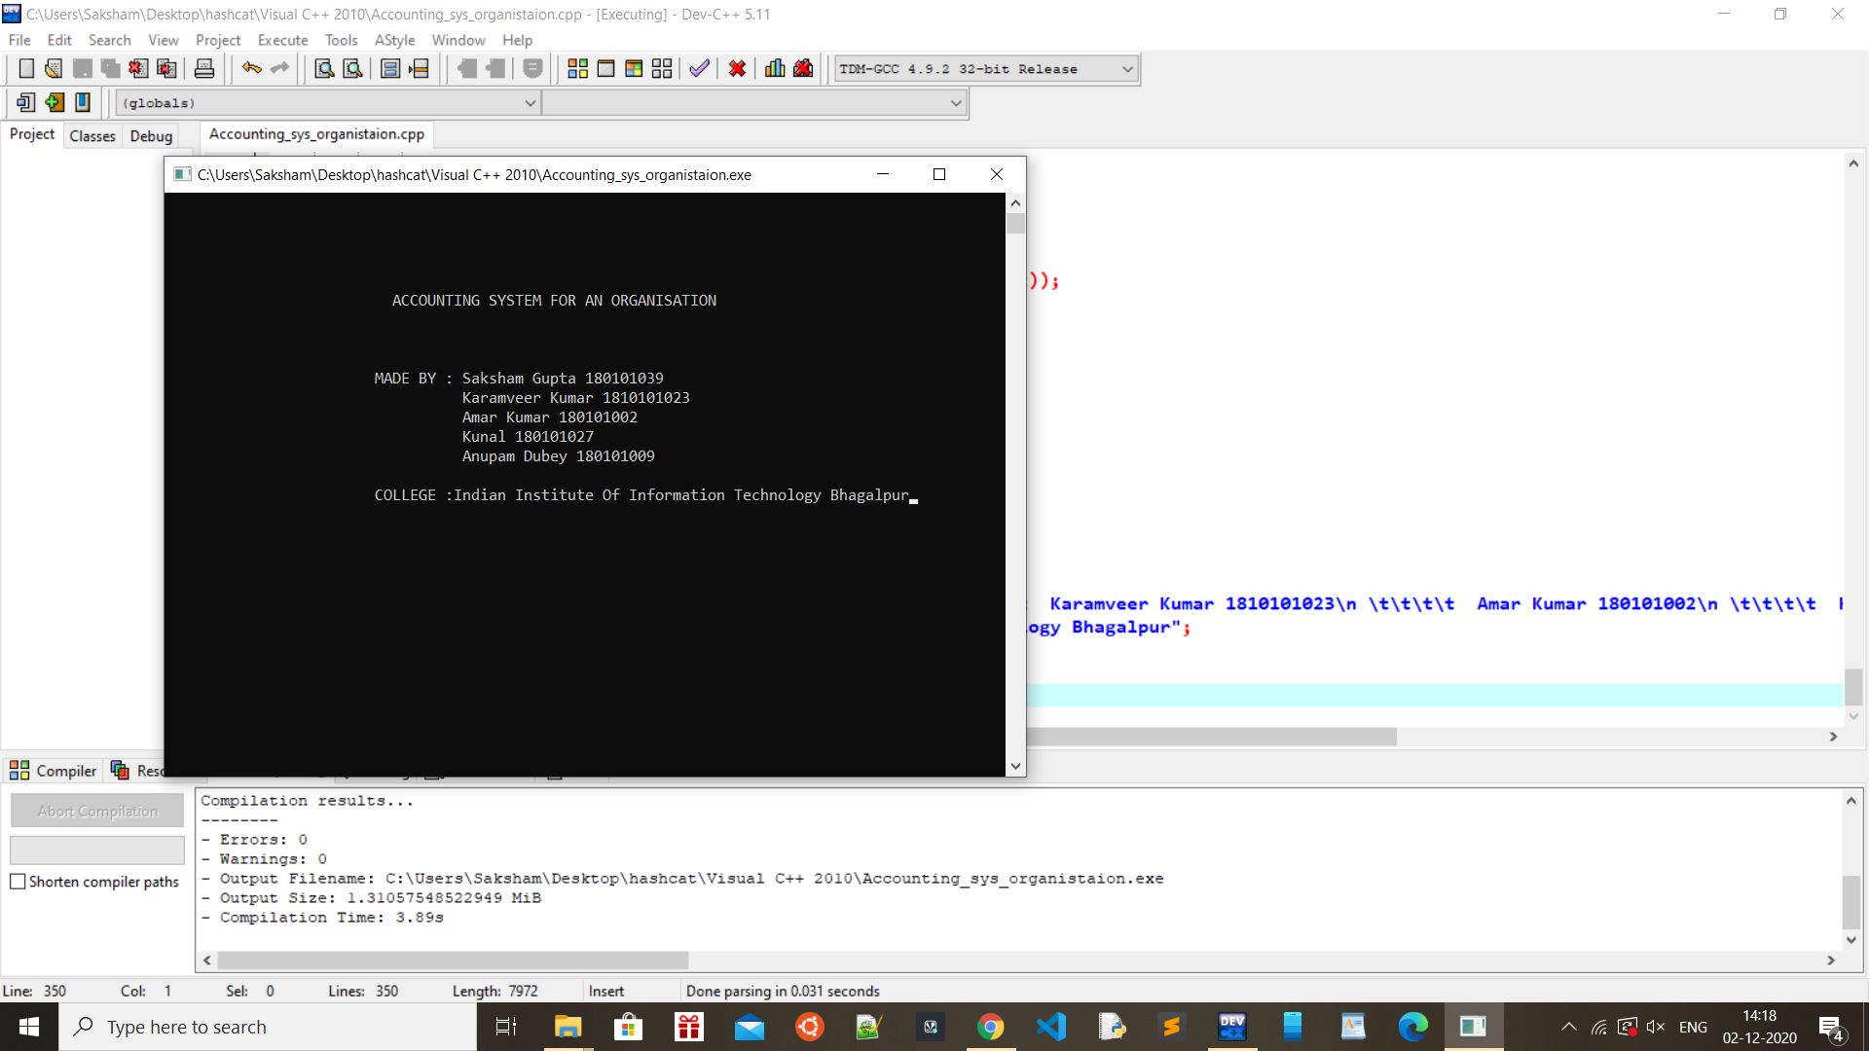
MAIN PAGE
OUTPUT
This the main page or the first screen that will appear after running the application.

Slide 8
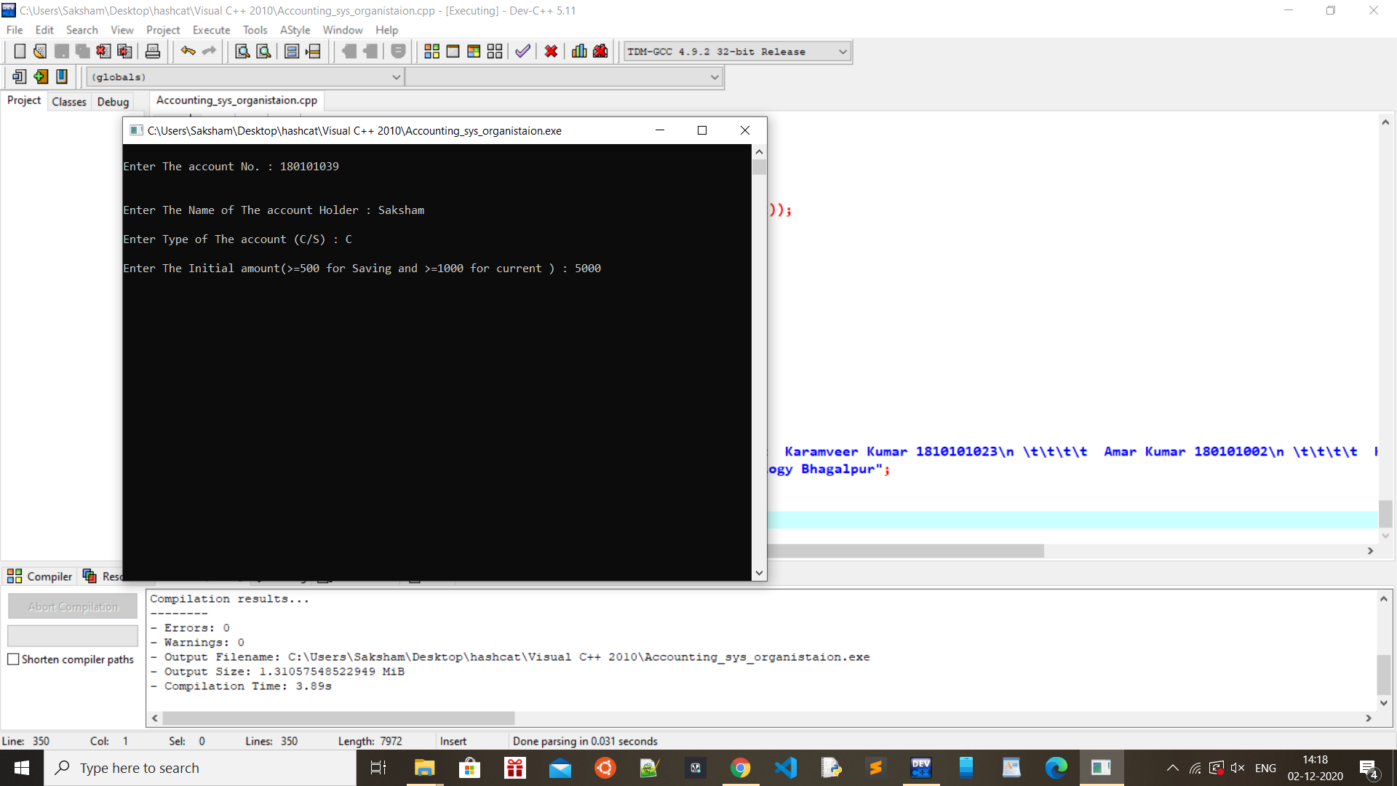
NEW ACCOUNT CREATION
This page showing the account creation page in which you will have to enter the account number and account type and initial amount

Slide 9
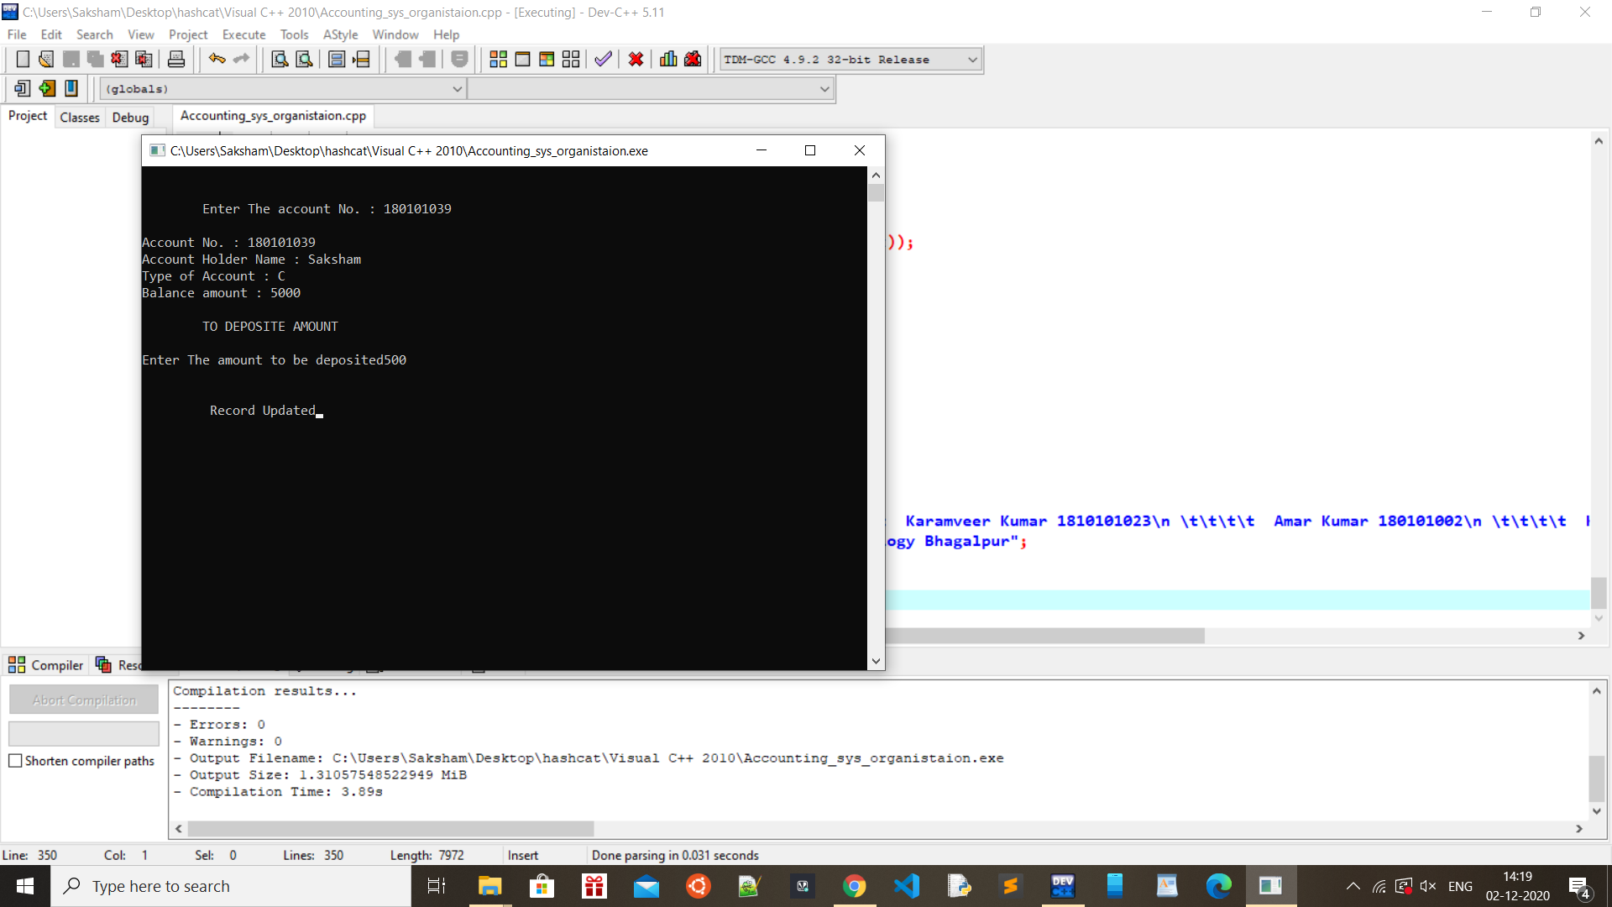
DEPOSTING MONEY
Page showing the interface where money is deposited in account

Slide 10

BALANCE ENQUIRY
User will get to know the account balance after entering his/her account number.

Slide 11
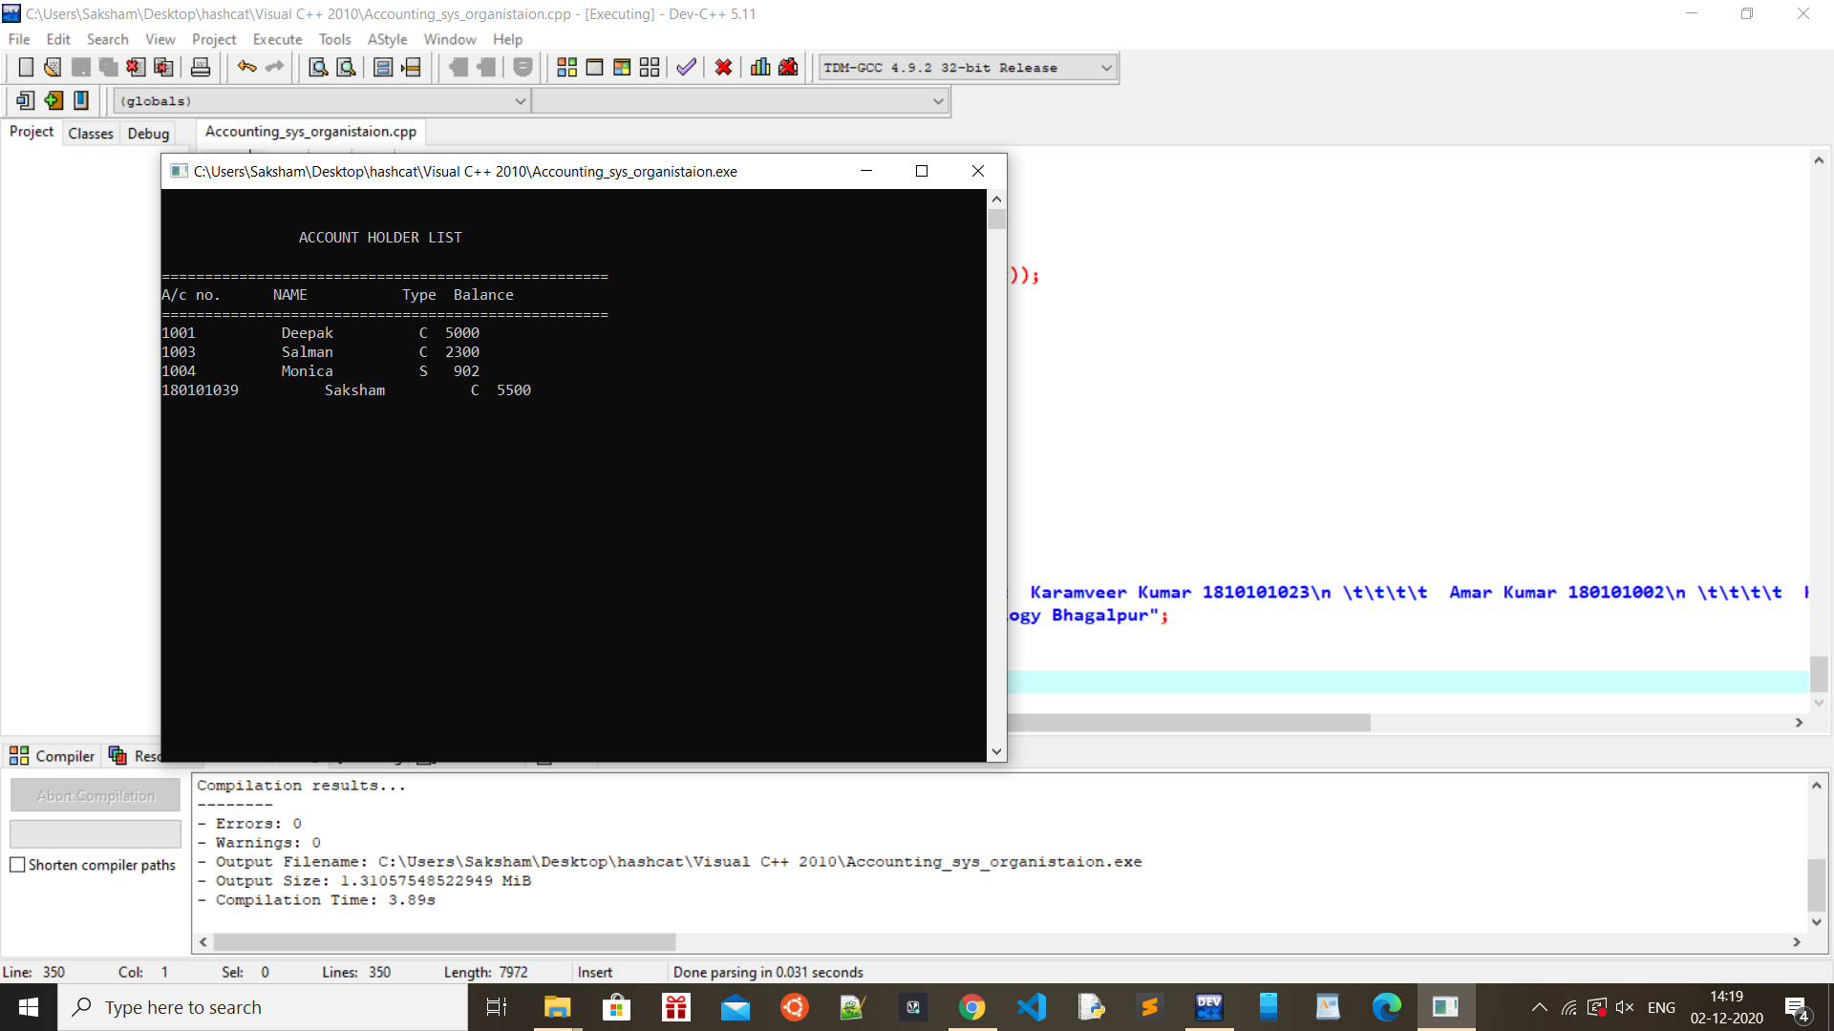
Showing all account holder list
Leads can see details of all the employees.

Slide 12
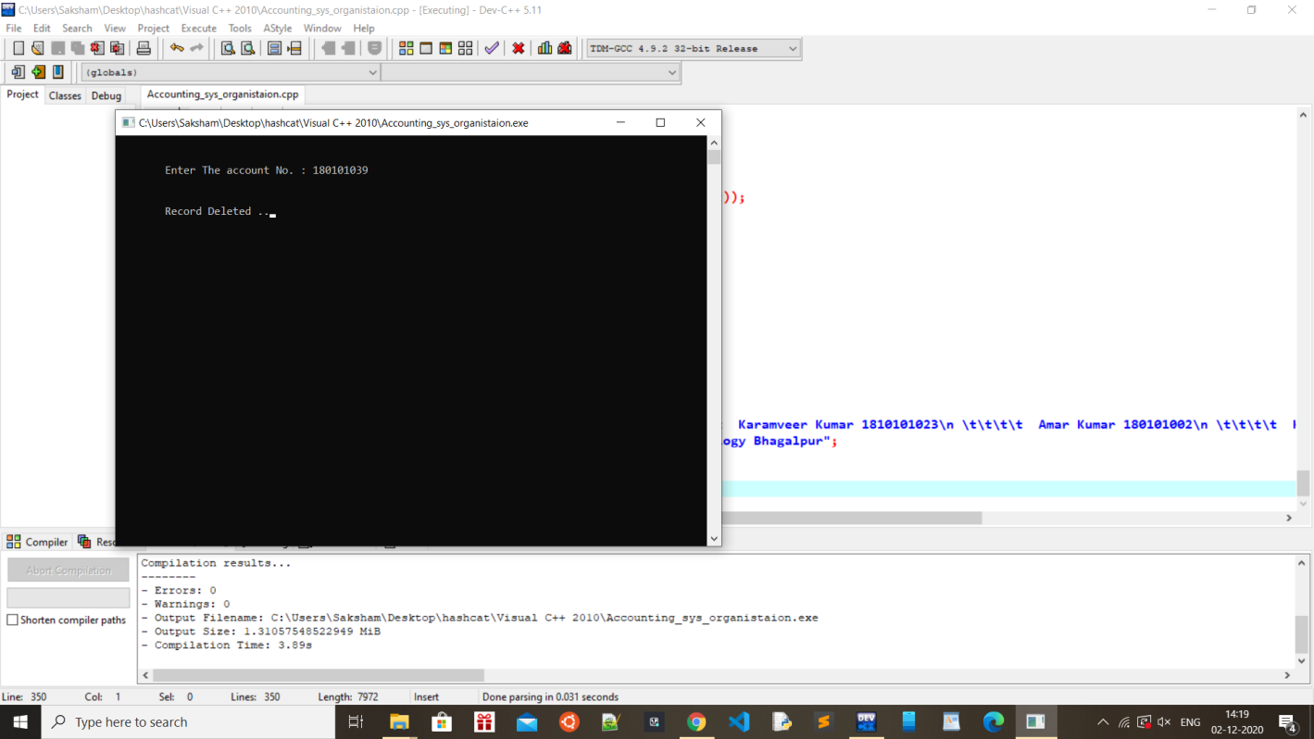
Account deletion
Leads can delete the info of an employees if needed.

Slide 13
THANK YOU!

